Slide 1
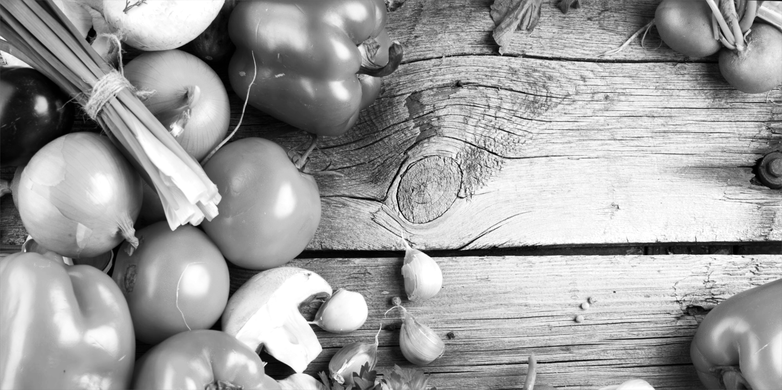

Calorie Cam

Slide 2


Slide 3






Notes:
That’s almost 10 percent of men and 14 percent of women-and it’s nearly double the rate of obesity in 1980.
Nearly 1.5 billion adults were overweight or obese (defined as a BMI of 25 or higher).

Slide 4

Notes:
In canada, from 2015 study,
Over 4/10 men overweight or obese
Close to 3/10 women

Slide 5


The Idea:
Notes:
How are we going to solve it?
+ target demographic

Slide 6
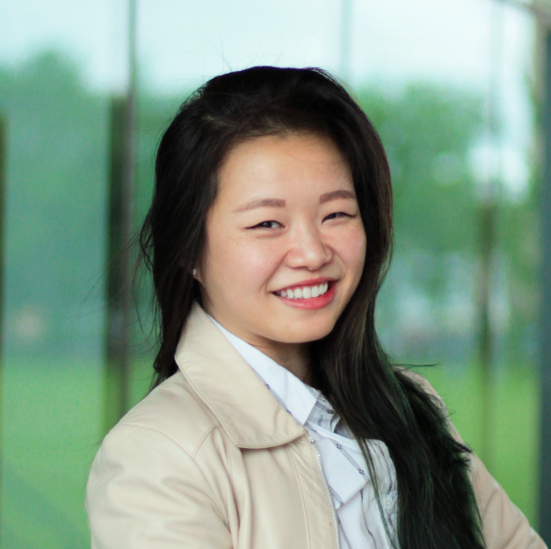
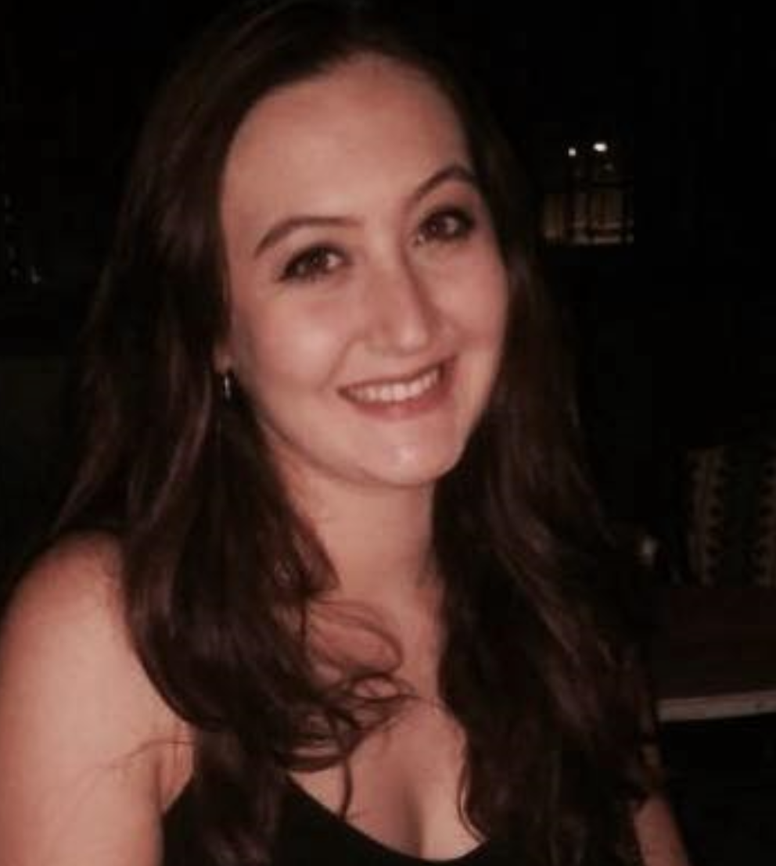
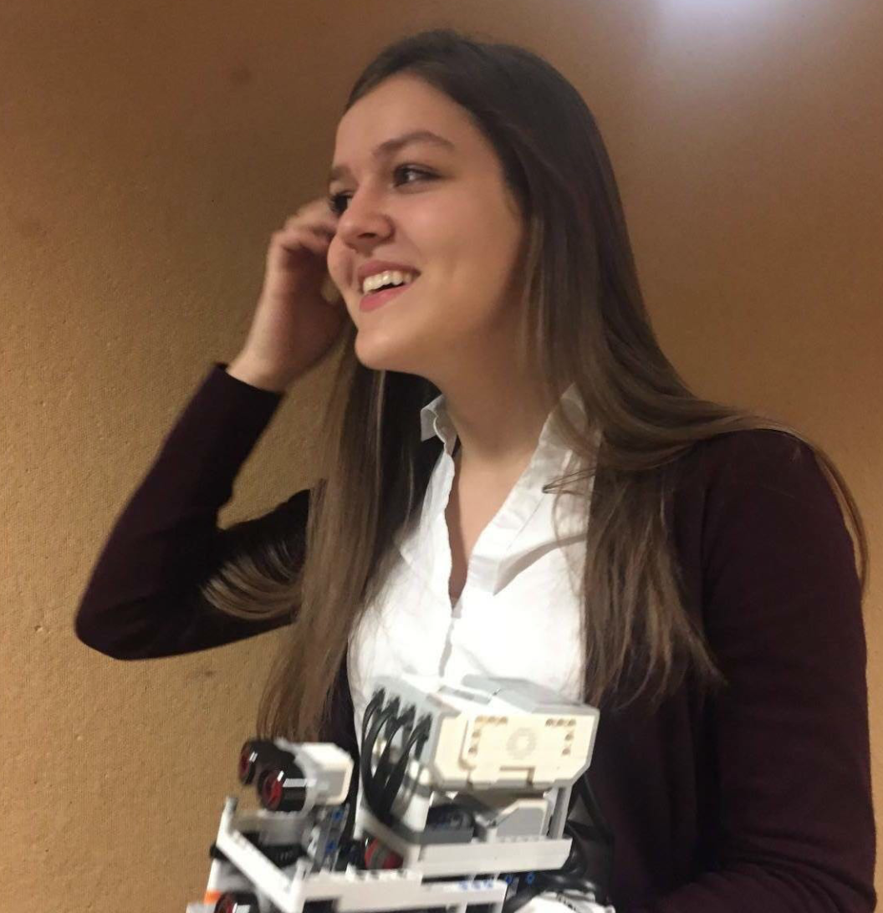
The Team:
Seasy huang
Anaelle Bitton
Myriam ayad
McGill U2
Bio & Computer Science
Mcgill U3
Software engineering
Mcgill U3
Software engineering
Notes:
Why are you the right people to find it

Slide 7
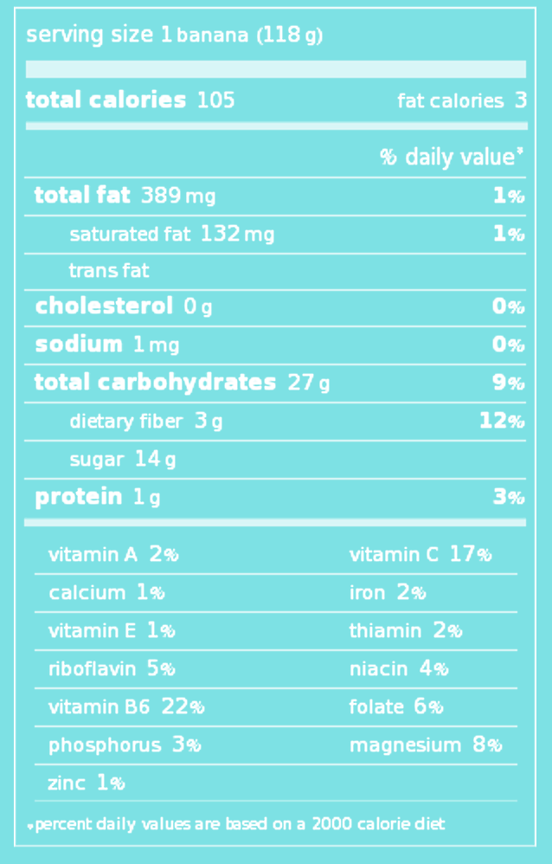
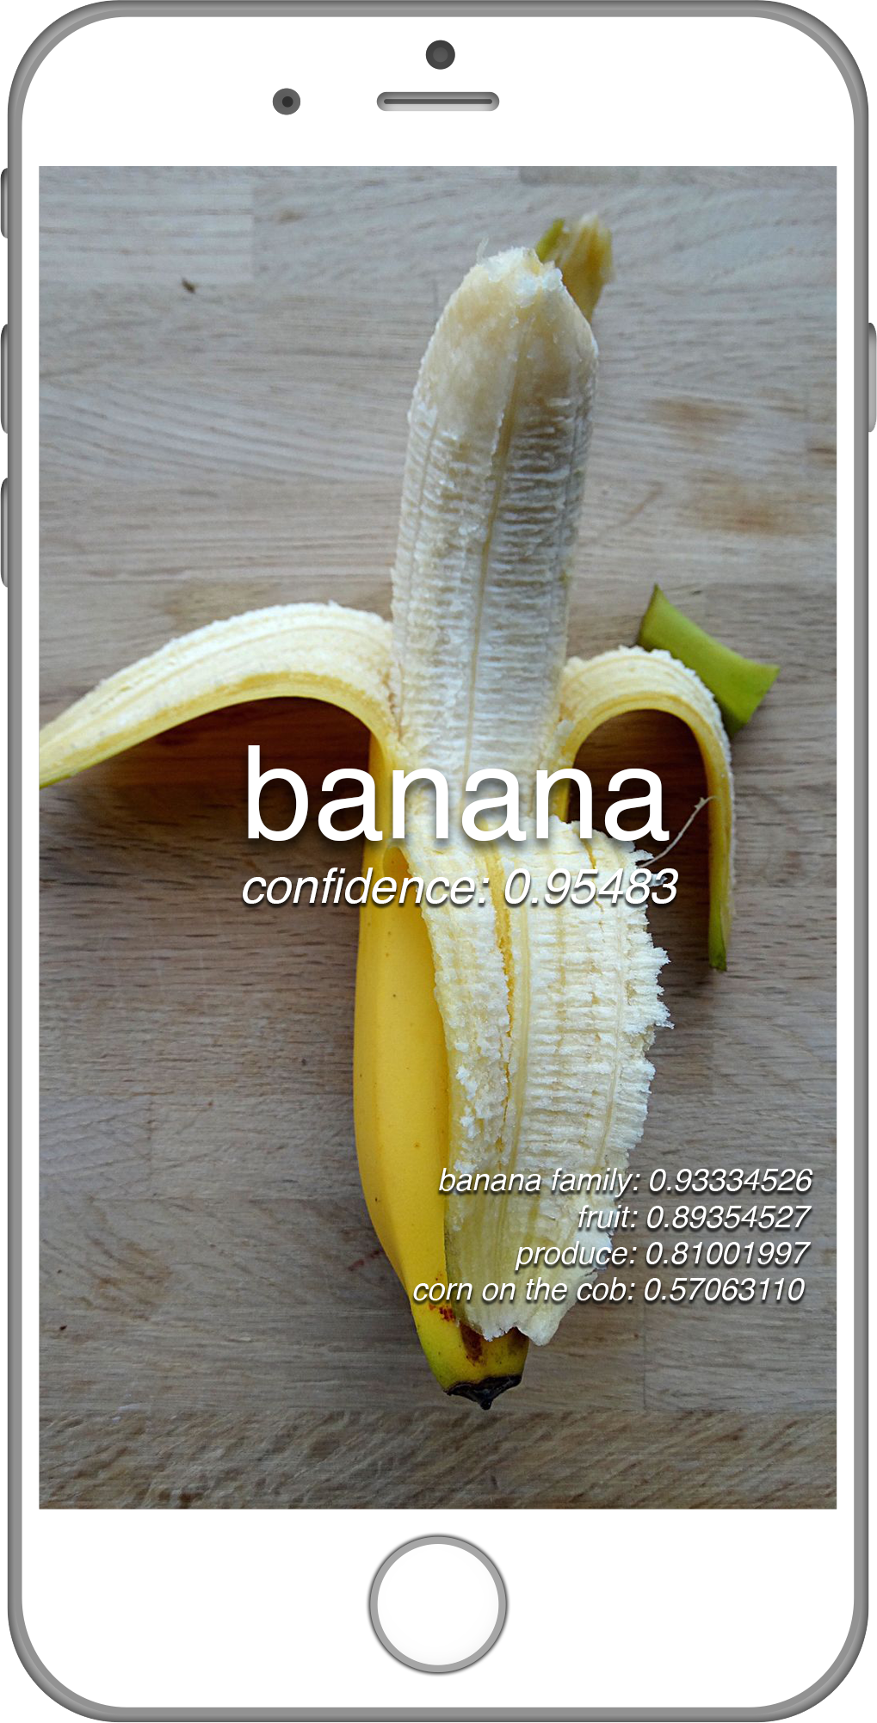
Part 1: Identify

Slide 8
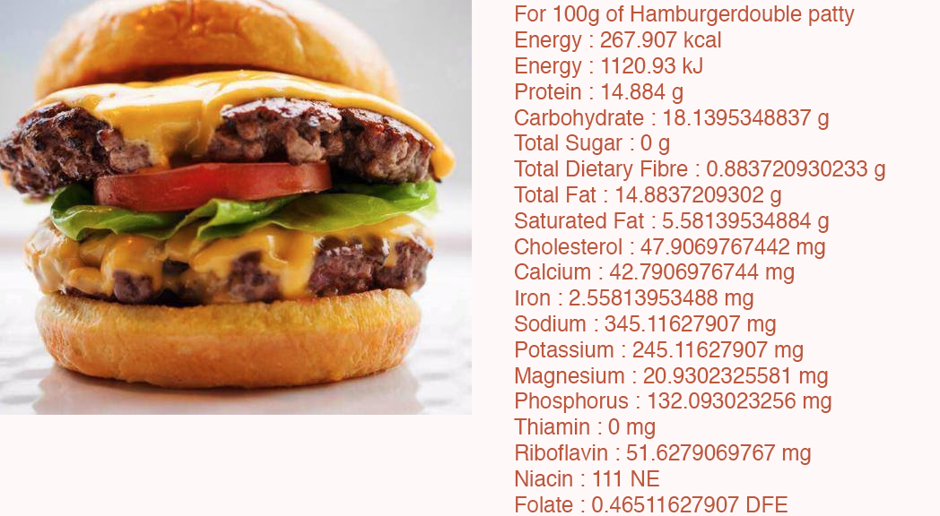

Slide 9
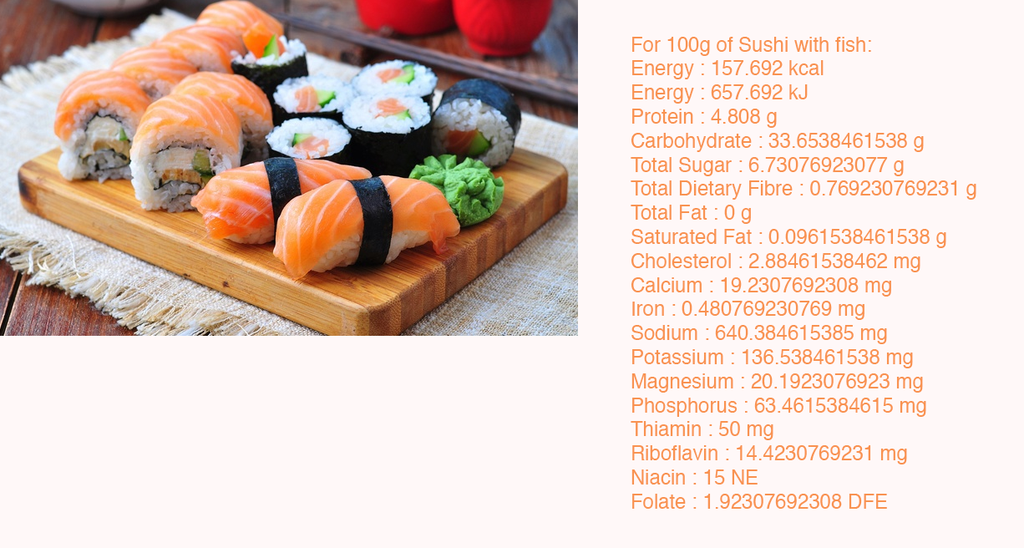

Slide 10
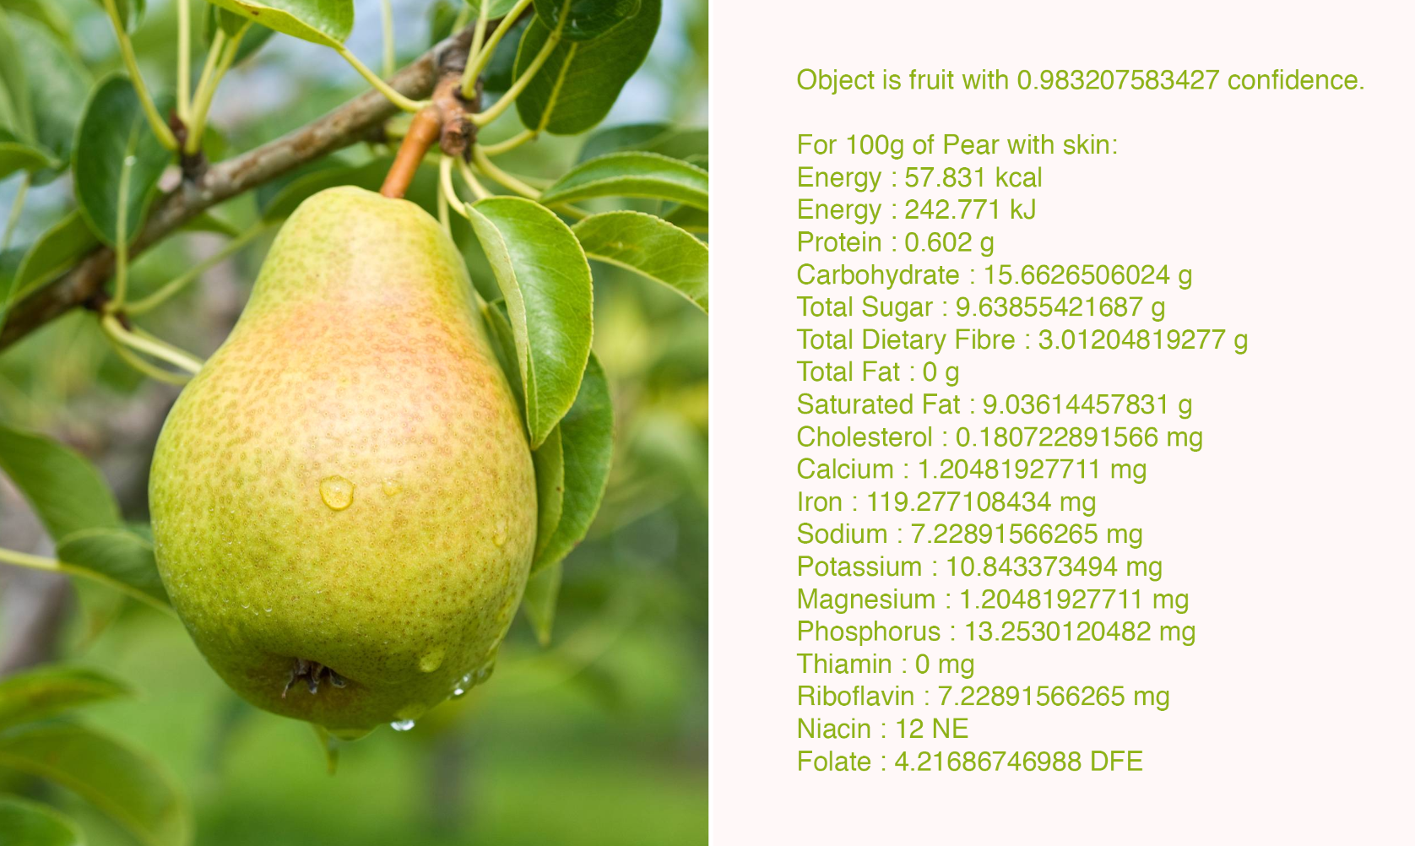

Slide 11
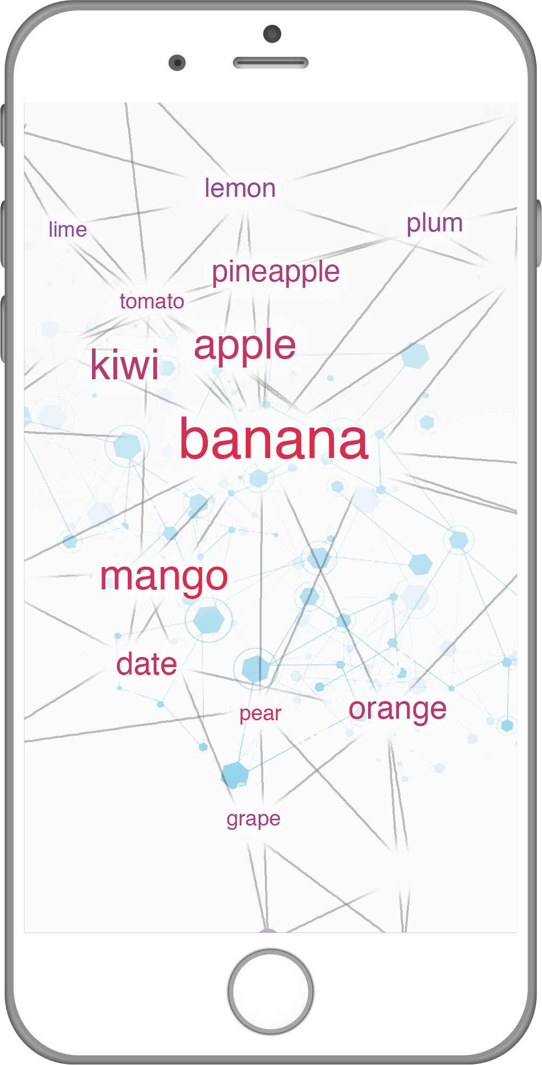
Part 2: Cluster

Slide 12
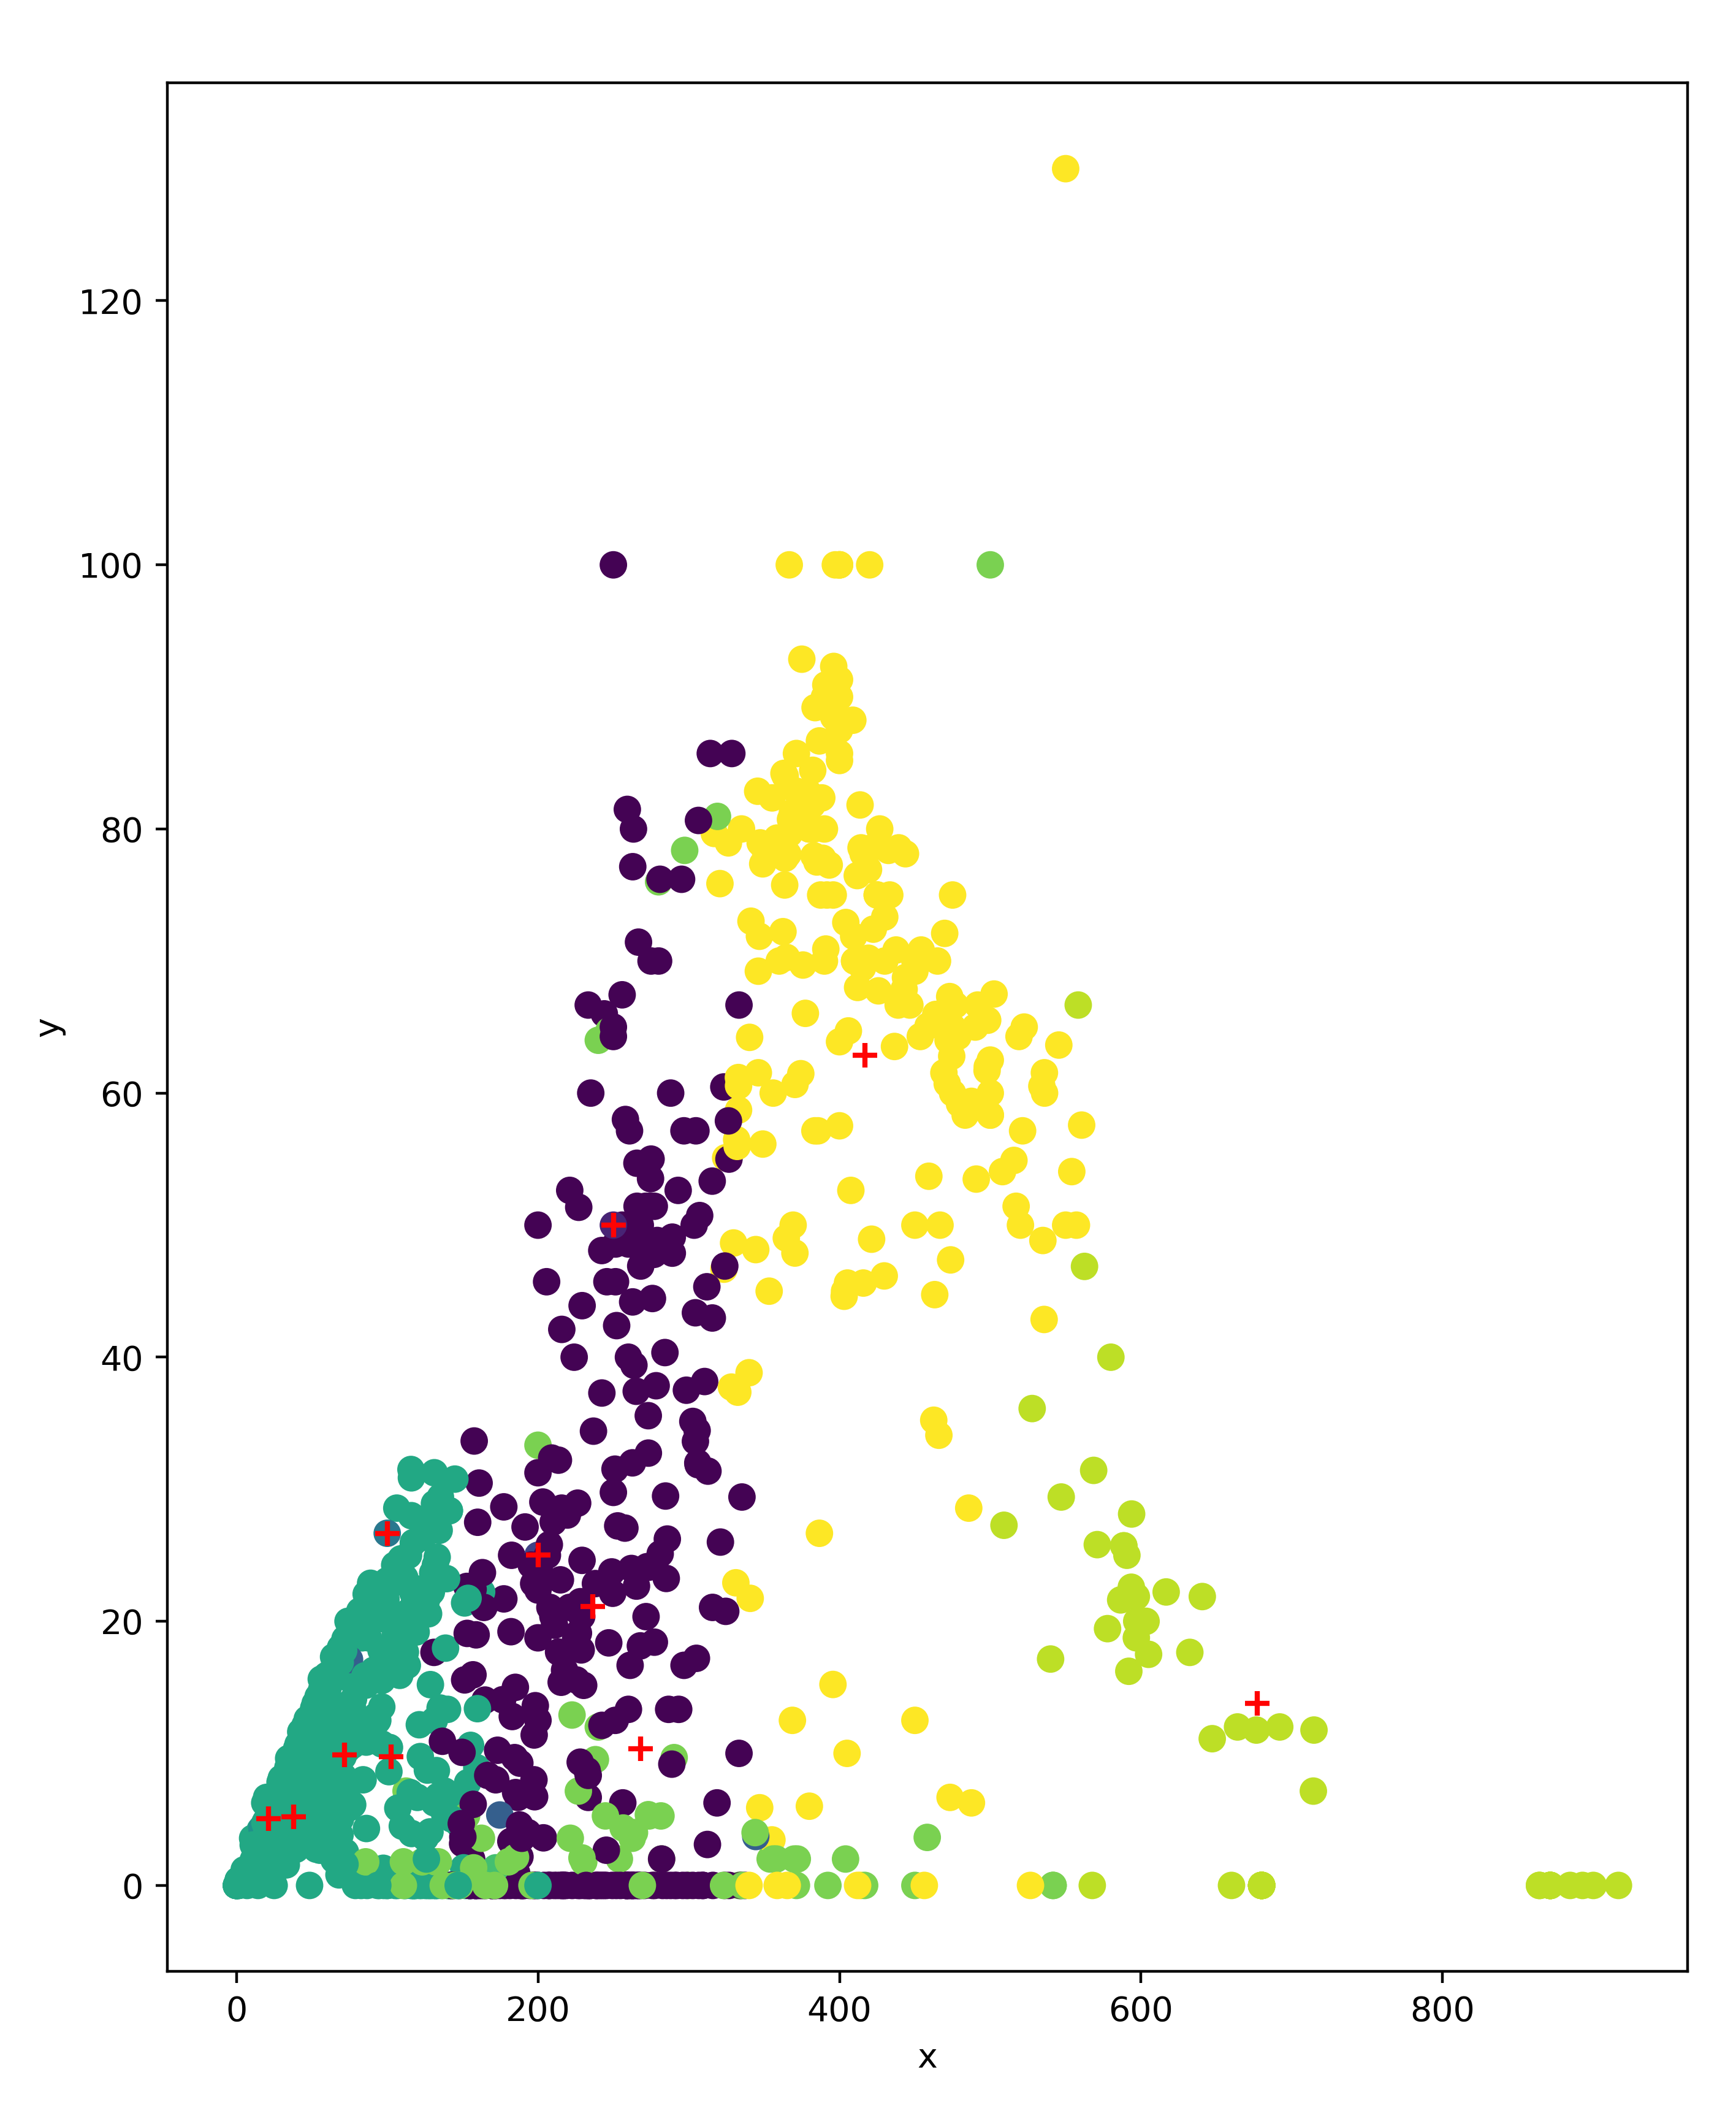
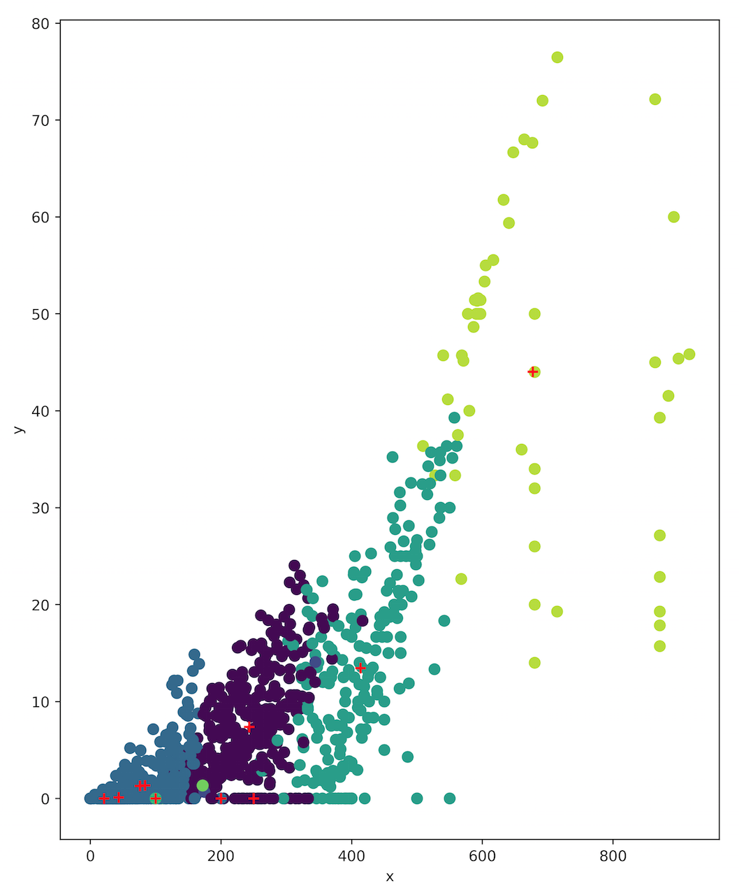
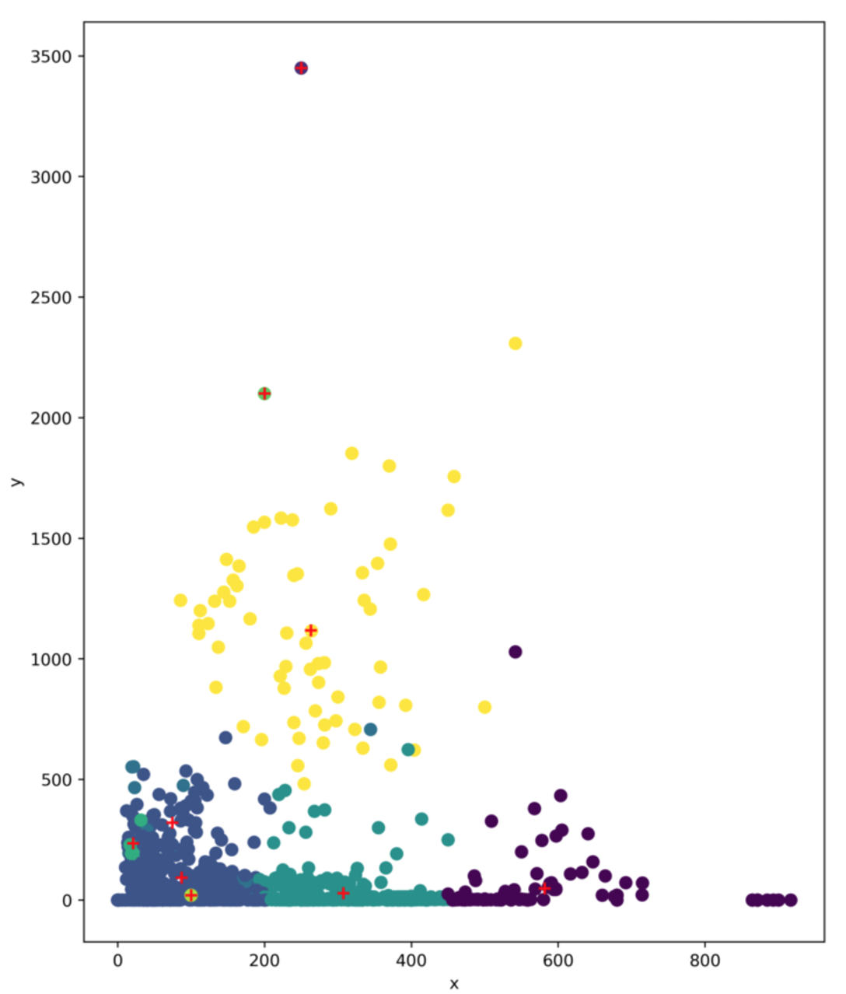
Part 2: Cluster
Calories and carbs
Calories and Fat
Calories and iron

Slide 13
Part 3: Future steps
Refine dataset
App deployment
App prototype

Slide 14
Notes:
Just a step in…
Hopefully with its accessibility
Etc
Make healthier decisions
More importantly
Live healthier lives

